Slide 1
MIALab Final Presentation
Julian Rösch und Timo Kofmehl

Slide 2
Hypothesis 4
Given at the beginning of the lab is the random forest classifier. Is this the best suiting classifier for brain segmentation? Are there any more accurate or faster alternatives?

Slide 3
Pipeline
Registration
Pre-processing
Feature Extraction
Classification
Post-processing

Slide 4
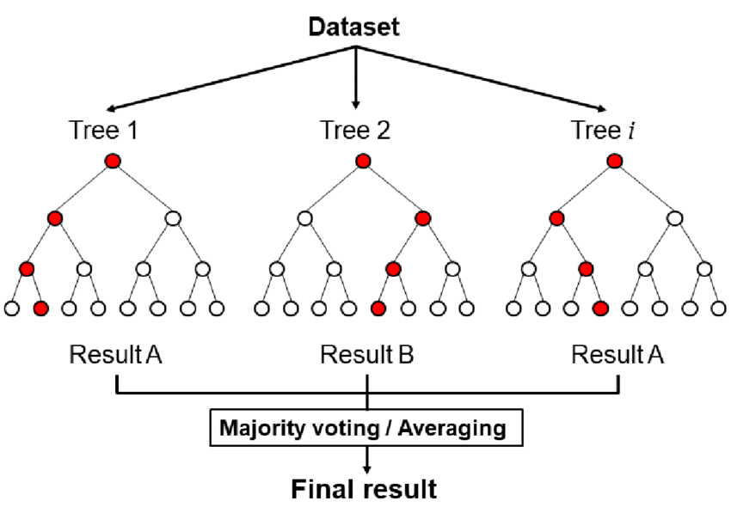
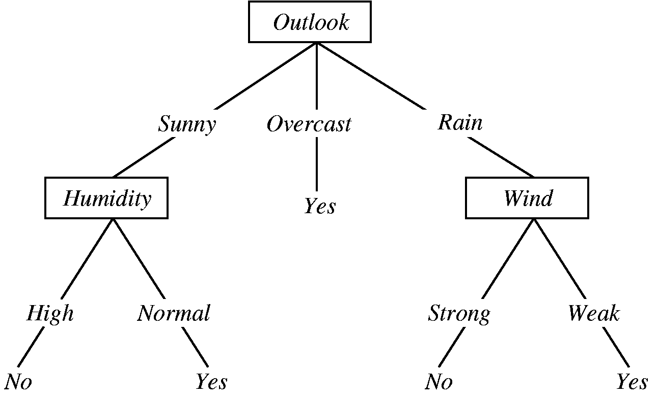
Tested Classifiers
Decision Tree
Notes:
https://www.researchgate.net/figure/11-Schematic-diagram-of-the-random-forest-classifier_fig9_353045870
https://cloudmark.github.io/Decision-Trees/

Slide 5
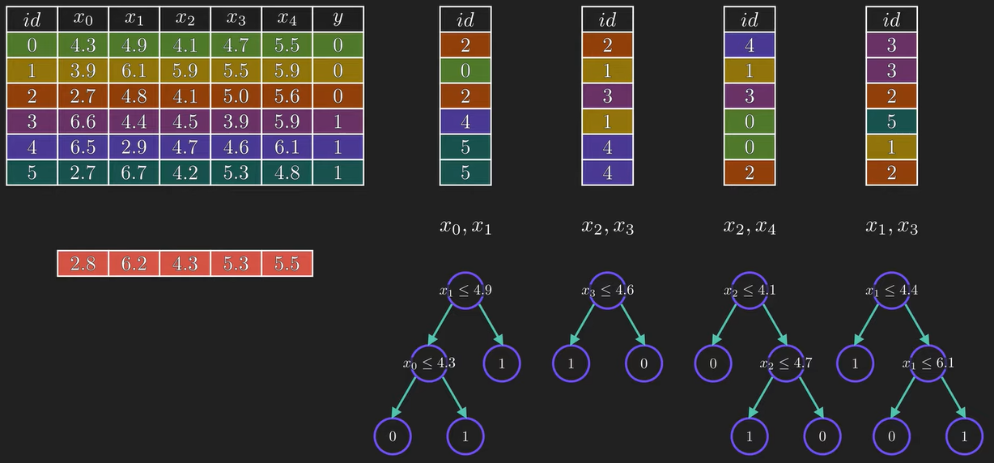
Tested Classifiers
Decision Tree
Random Forest
Notes:
https://www.researchgate.net/figure/11-Schematic-diagram-of-the-random-forest-classifier_fig9_353045870
https://cloudmark.github.io/Decision-Trees/

Slide 6
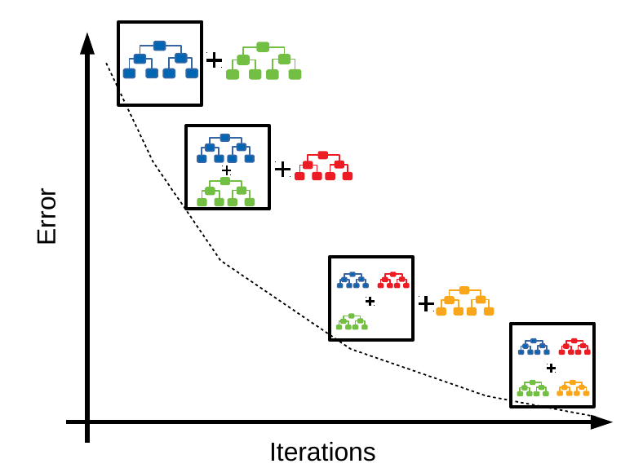
Tested Classifiers
Decision Tree
Random Forest
Gradient Boost
Notes:
https://www.researchgate.net/figure/11-Schematic-diagram-of-the-random-forest-classifier_fig9_353045870
https://cloudmark.github.io/Decision-Trees/

Slide 7
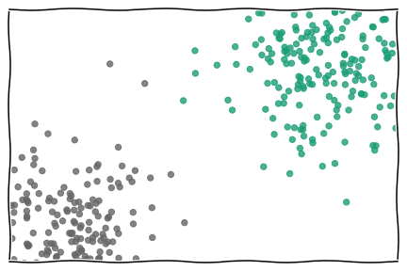
Tested Classifiers
Decision Tree
Random Forest
Gradient Boost
K Nearest Neighbor
Naive Bayes
Logistic Regression
RGB SVM
Gaussian Process
Notes:
https://en.wikipedia.org/wiki/K-nearest_neighbors_algorithm

Slide 8
Compare the classifiers
Dice coefficient
Hausdorff distance
Runtime
Visually

Slide 9
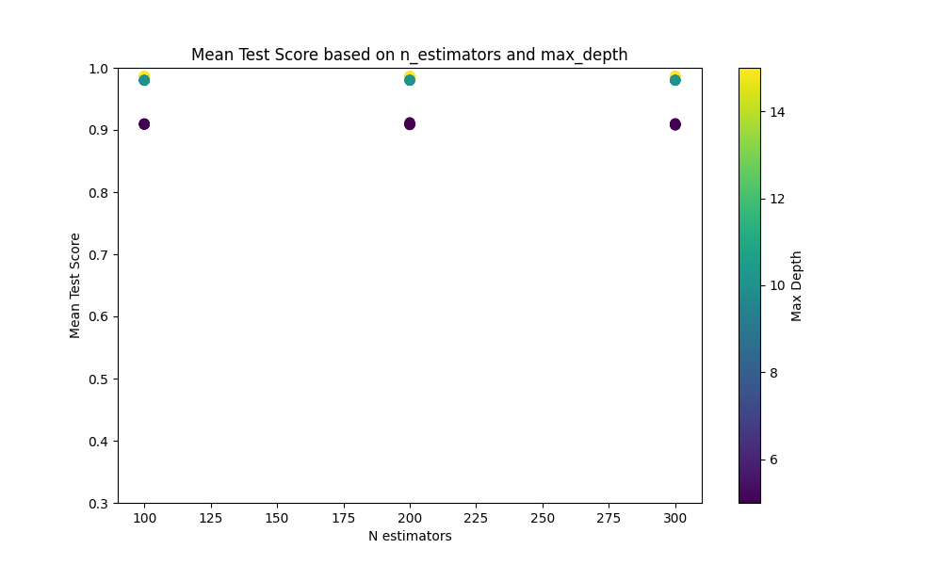
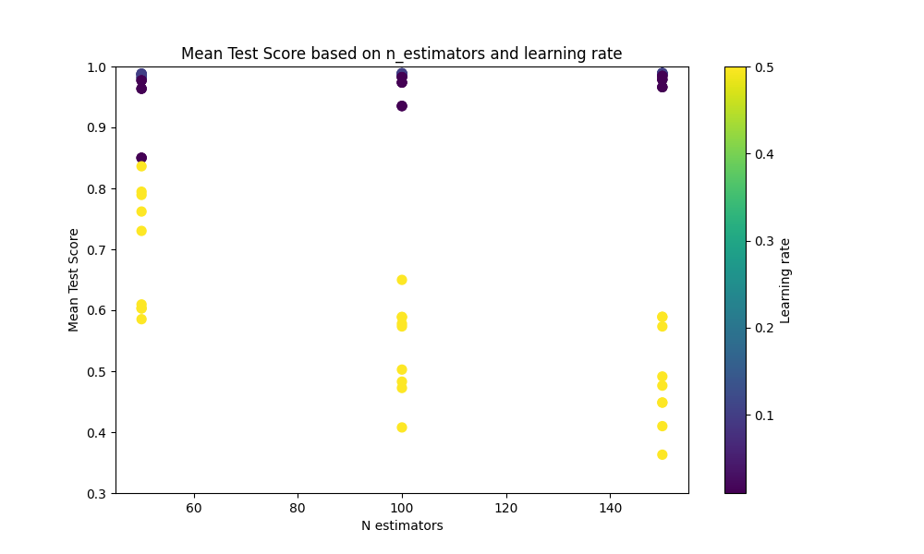
Parameter Search
Grid search for multiple parameters of the classifier
Number of estimators
Max depth
Learning rate
etc.
Random Forest
Gradient Boost

Slide 10
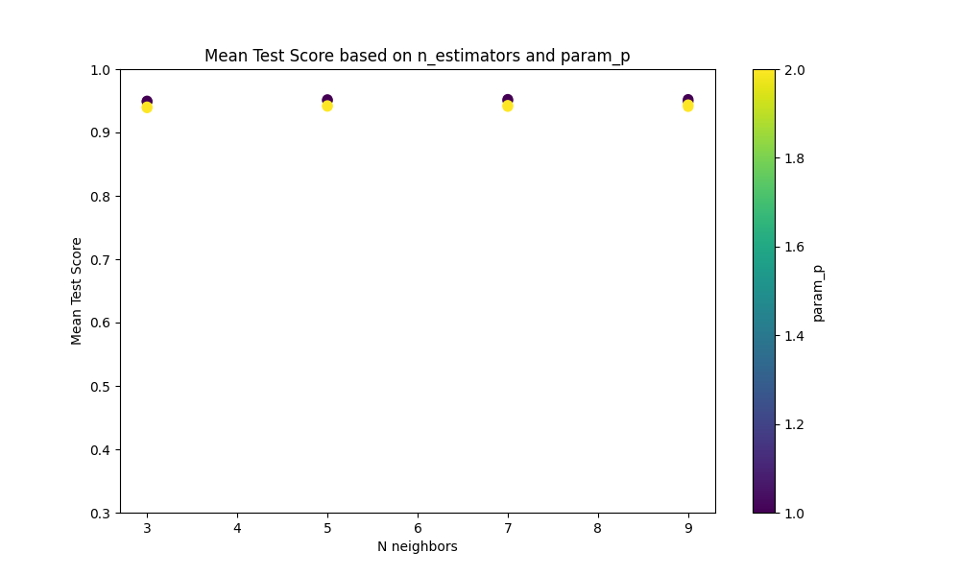
Parameter Search
Grid search for multiple parameters of the classifier
Number of estimators
Max depth
Learning rate
etc.
K-nearest Neighbor
k_neighbors
k_neighbors

Slide 11
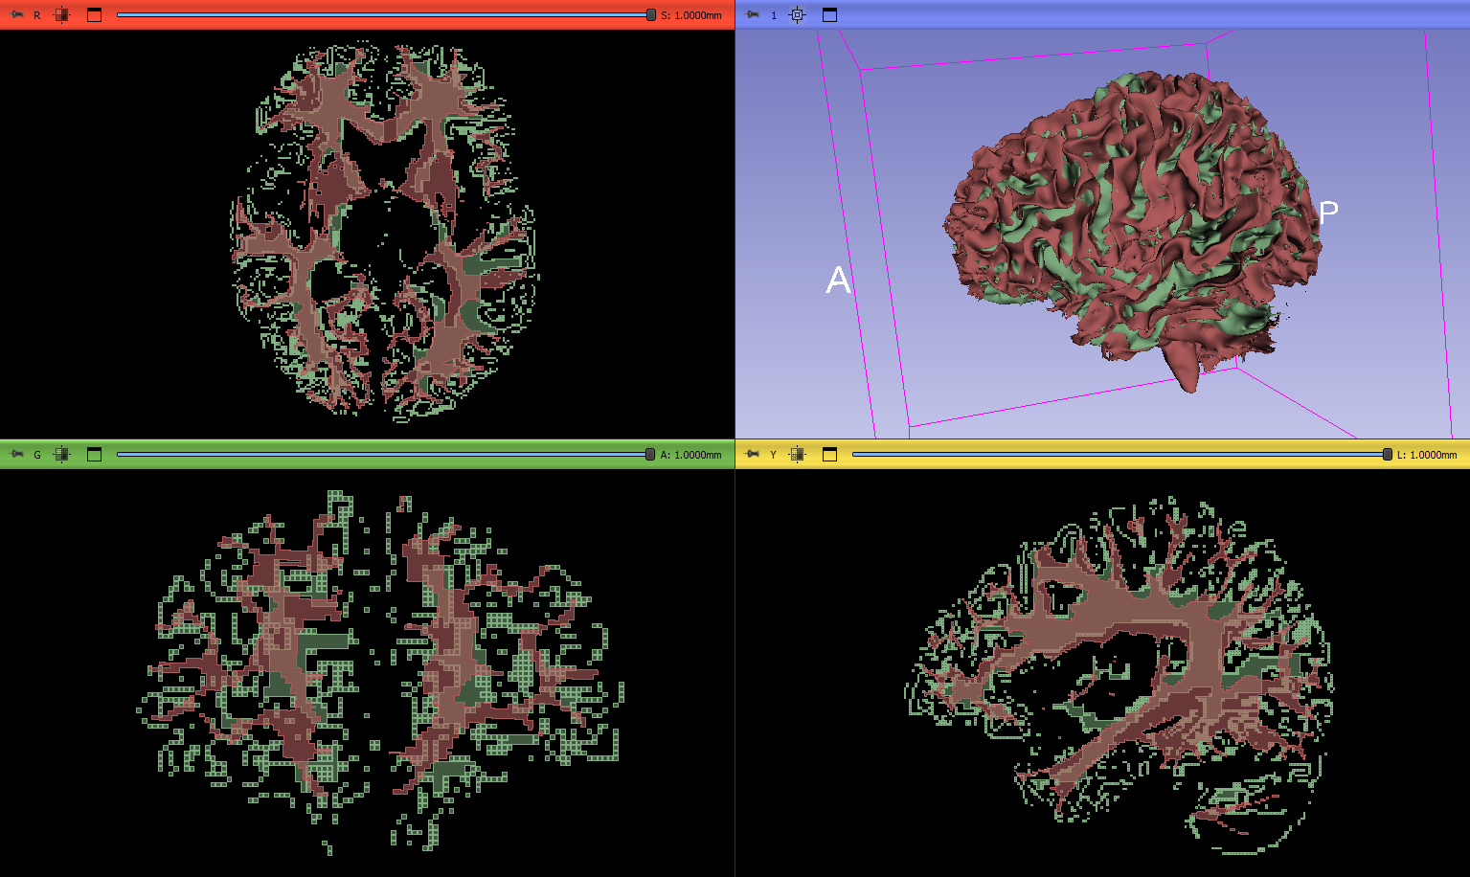
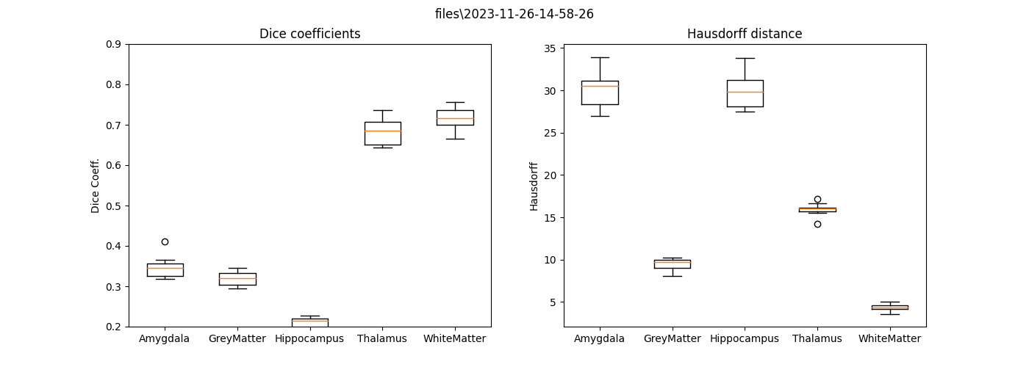
Naive Bayes
Notes:
White Matter

Slide 12
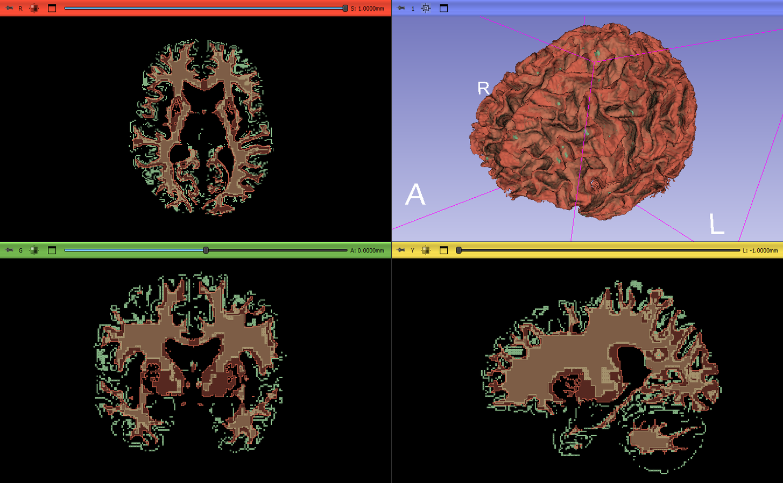
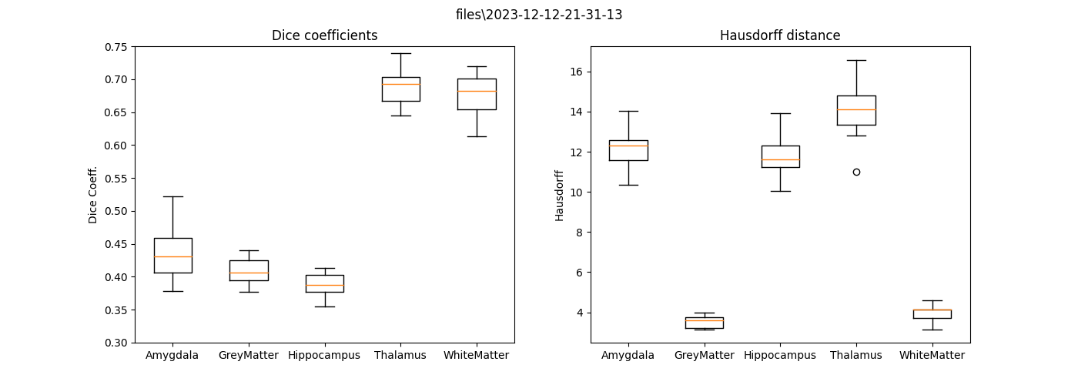
Random Forest

Slide 13
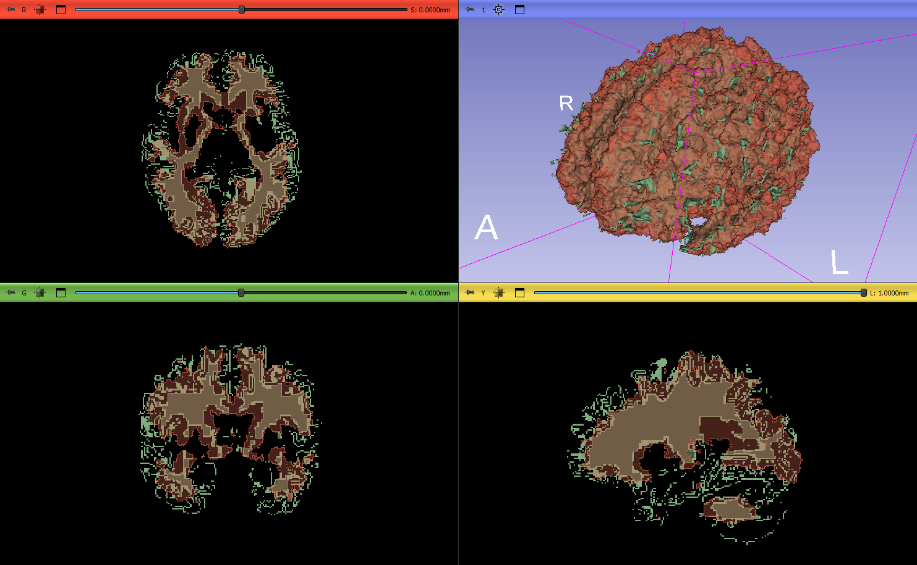
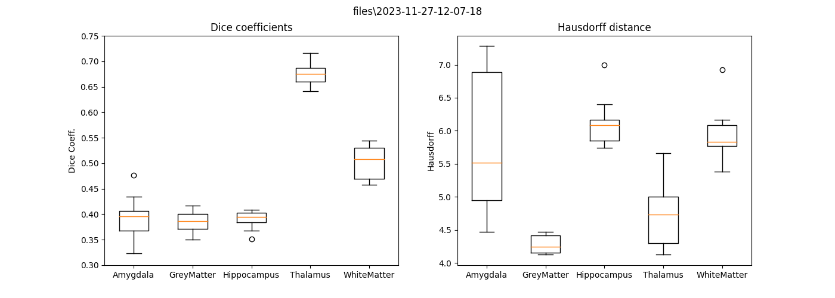
K-nearest Neighbor

Slide 14
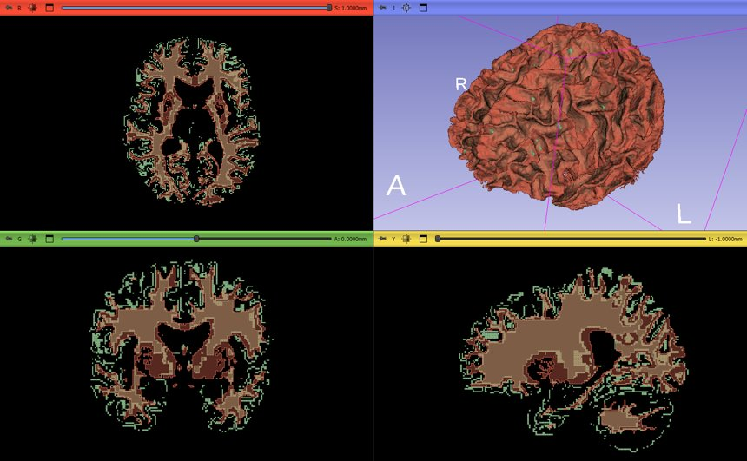
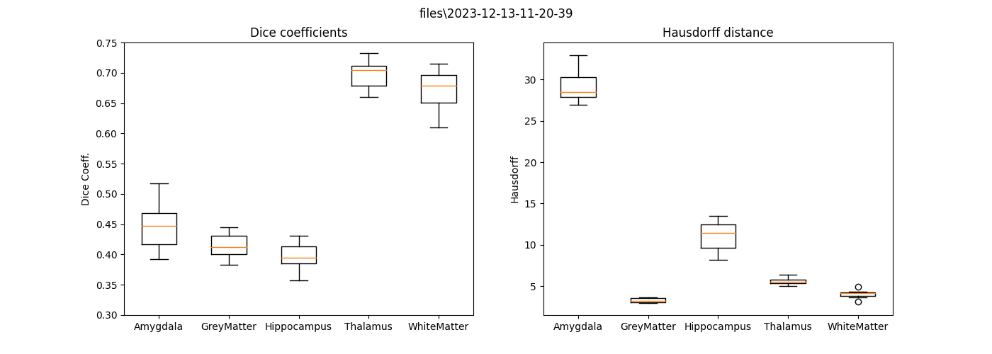
Gradient Boost

Slide 15
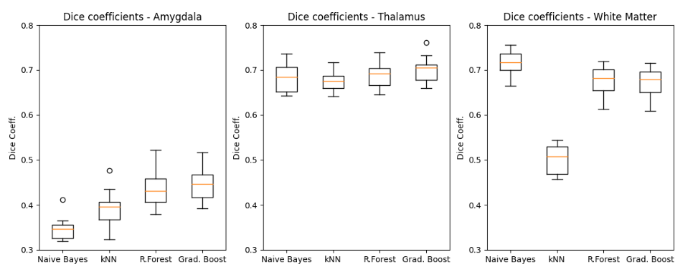
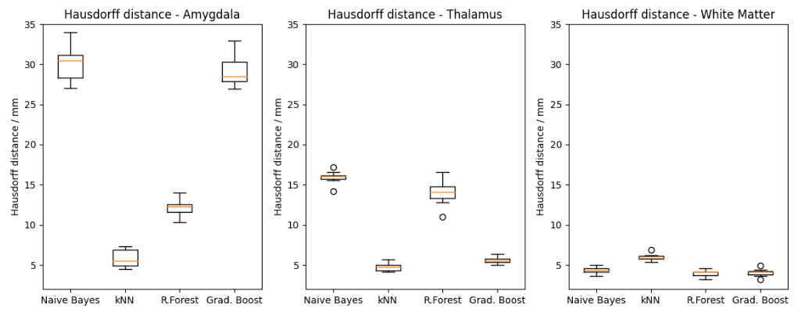
Conclusion
Notes:
Randomforest good Dice, medium large Hausdorff, Runtime ok
Gradient Boost big potential, more optimization needed
Decision Tree very fast

Slide 16
Hypothesis 4
Given at the beginning of the lab is the random forest classifier. Is this the best suiting classifier for brain segmentation? Are there any more accurate or faster alternatives?
Notes:
Gradient Boost is very promizing, but more parameter optimization is needed.

Slide 17
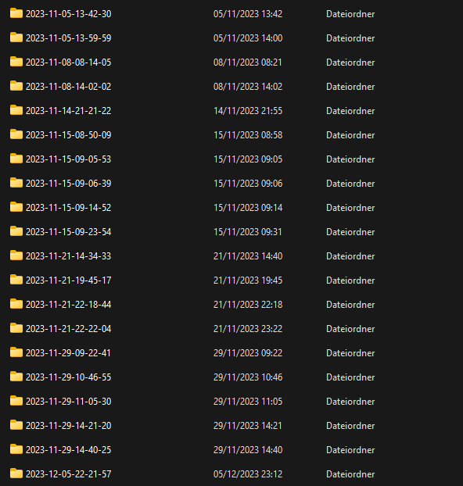
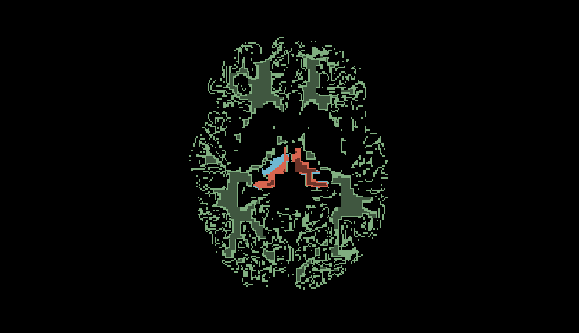
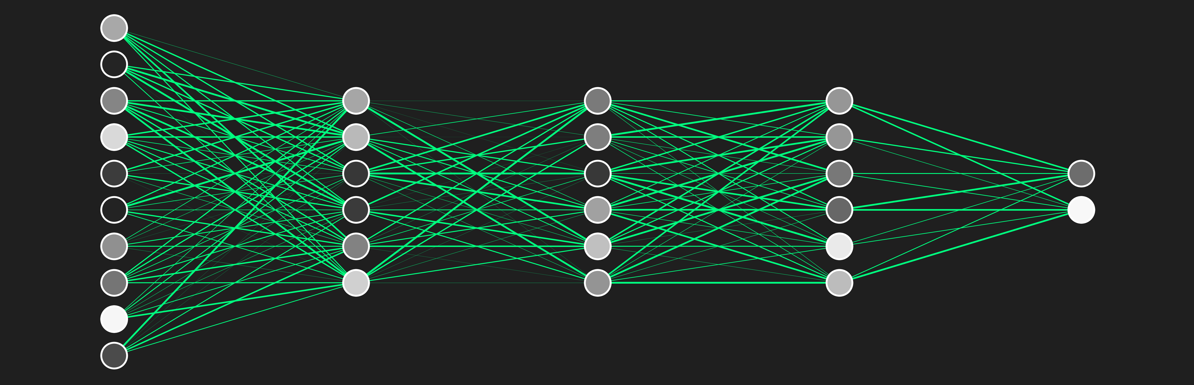
Outlook
Ground truth
Better data management
Neural network and SVM

Slide 18


Slide 19
References
Information:
https://scikit-learn.org/stable/ - all information related to classifiers
Images:
Slide 4 - https://cloudmark.github.io/Decision-Trees/, 18.12.2023
Slide 5 - https://www.youtube.com/watch?v=v6VJ2RO66Ag, 18.12.2023
Slide 6 - https://medium.com/swlh/gradient-boosting-trees-for-classification-a-beginners-guide-596b594a14ea, 18.12.2023
Slide 7 - https://towardsdatascience.com/getting-acquainted-with-k-nearest-neighbors-ba0a9ecf354f , 18.12.2023

